Slide 1

WOMEN AND IT’S POVERTY LEVEL IN INDIA
A Step Towards Equity
Presented by:-
Amisha, Teesha, Sangam
Presented by - Teesha, Amisha,Sangam

Slide 2

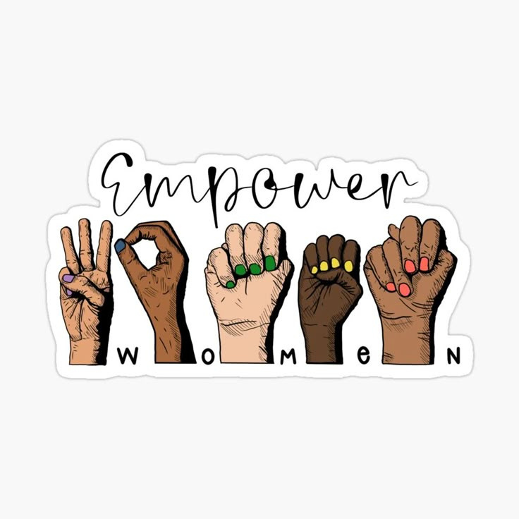
WOMEN EMPOWERMENT
  Women empowerment means giving women the right to make their own decisions and live with dignity and freedom.
  It ensures equal access to education, healthcare, employement, and participation in decision-making.
  Empowered women contribute to the progress of families, communities, and the nation.

Slide 3
IMPORTANCE OF WOMEN EMPOWERMENT
01
02
03
Promotes social
and economic
development
Improves literacy,
health, and overall
living standards
Leads to gender
equality and
sustainable growth

Slide 4
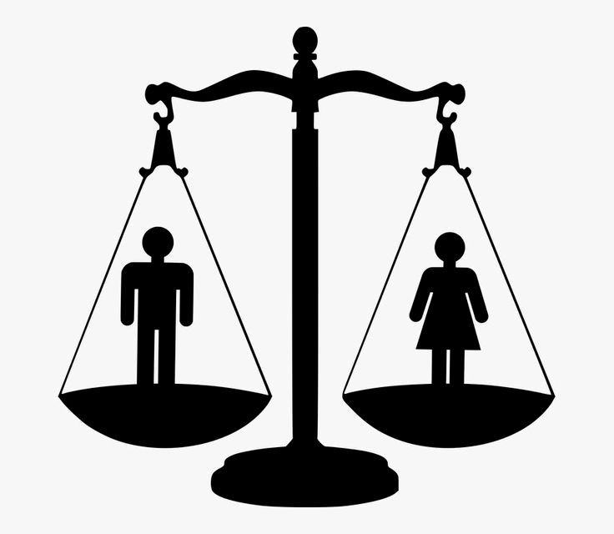
GENDER INEQUALITY
Gender inequality refers to the unequal treatment and opportunities given to individuals based on their gender.
In India, it is a major social issue that affects women in various aspects of life such as education, employment, health, and political participation.
Women often face lower wages, limited access to property rights, and fewer leadership opportunities compared to men. Deep-rooted social norms, early marriages, and lack of awareness further widen this gap. Although the government has launched several schemes and awareness campaigns to promote gender equality, the mindset of society still needs change.
True progress can only be achieved when both men and women are treated equally and given the same opportunities to grow and succeed.

Slide 5

WOMEN
LITERACY
Women literacy means the ability of women to read, write, and gain knowledge
for their personal and social development.
It plays a crucial role in empowering women and
improving the overall growth of society.
Educated women are more confident, aware of their rights,
and capable of making
better decisions for their families and careers.
Lack of education among women leads to unemployment,
poverty, and gender inequality.
Therefore, promoting female education is essential
to build a balanced, progressive, and empowered nation.

Slide 6
Gender inequality in India has gradually decreased over the past few Years due to Improved Education, Employment, and Empowerment Opportunities for Women.
With continued focus on Empowerment, Skill training, and Equality, India can further reduce gender gaps and lift more Women out of poverty in the coming years.

Slide 7

“When women rise, families and nations rise with them.”
A gender-equal India needs equal access, inclusion, and respect.
Poverty among women is a social justice issue.
Together, we can bridge the gap through awareness and policy.

Slide 8
“Awake, Arise and Educate
Smash Traditions, Liberate”
Savitribai Phule
India’s First Female Teacher
Thank you

